Slide 1
Linked List

Slide 2
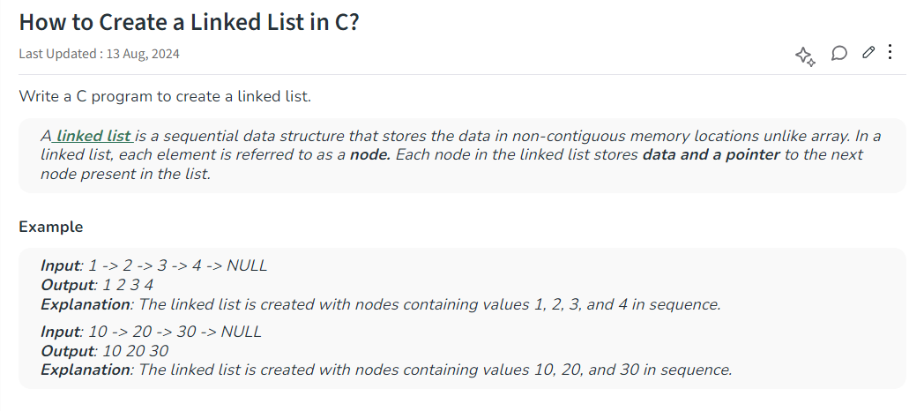

Slide 3
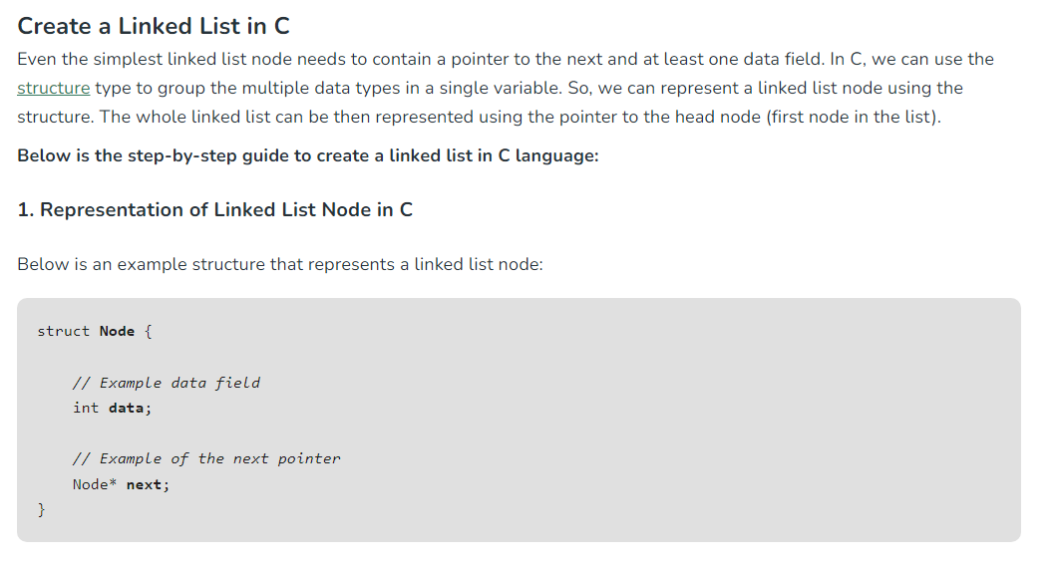

Slide 4
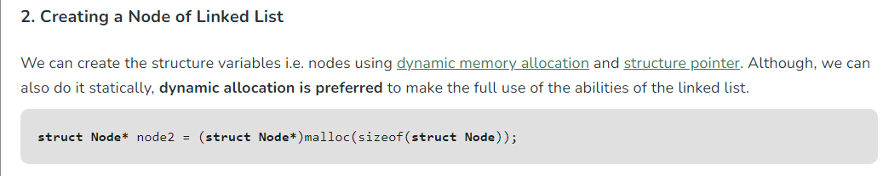
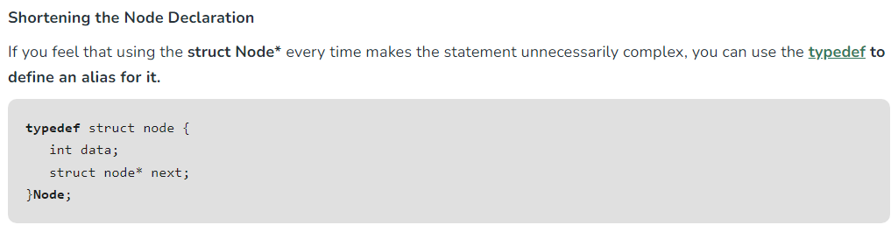

Slide 5
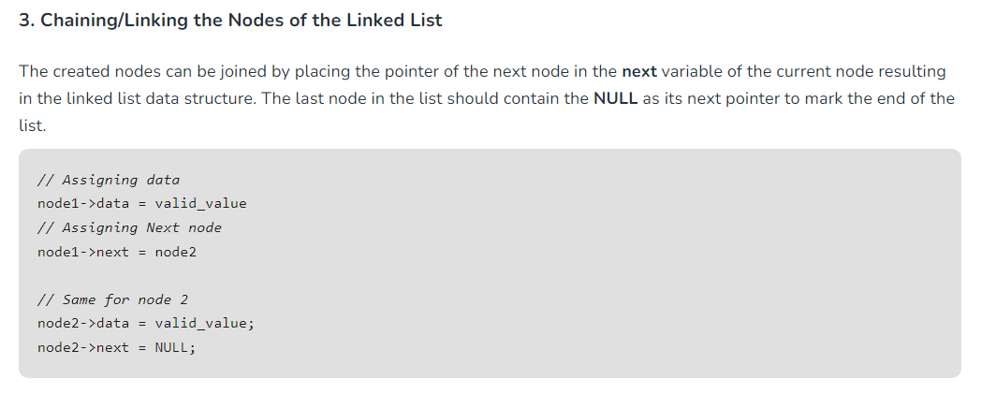

Slide 6
#include <stdio.h>
#include <stdlib.h>
// Define the structure of Node
typedef struct Node {
int data;
struct Node *next;
} Node;

Slide 7
int main() {
Node *first = (Node *)malloc(sizeof(Node));
first->data = 10;
Node *second = (Node *)malloc(sizeof(Node));
second->data = 20;
Node *third = (Node *)malloc(sizeof(Node));
third->data = 30;

Slide 8
// Linking the nodes
first->next = second; // This will create: 10 -> 20
second->next = third; // This will create: 10 -> 20 -> 30
third->next = NULL; // This will create: 10 -> 20 -> 30 -> NULL
printf("Linked List: ");
Node* temp = first;
while(temp) {
printf("%d ", temp->data);
temp = temp->next;
}
return 0;
}

Slide 9
Using function
#include <stdio.h>
#include <stdlib.h>
// Define the structure of Node
typedef struct Node {
int data;
struct Node *next;
} Node;

Slide 10
Node *createNode(int data) {
Node *newNode = (Node *)malloc(sizeof(Node));
newNode->data = data;
newNode->next = NULL;
return newNode;
}

Slide 11
int main() {
Node *first = createNode(10);
first->next = createNode(20);
first->next->next = createNode(30);
printf("Linked List: ");
Node *temp = first;
while (temp)
{
printf("%d ", temp->data);
temp = temp->next;
}
return 0;
}

Slide 12
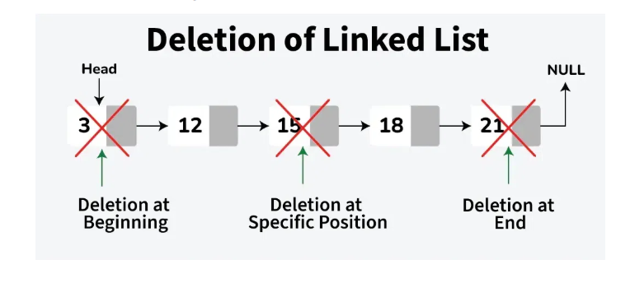
Deletion

Slide 13
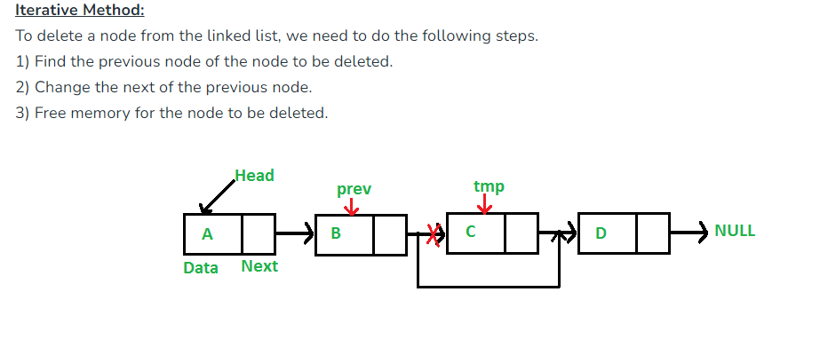
Contd..

Slide 14
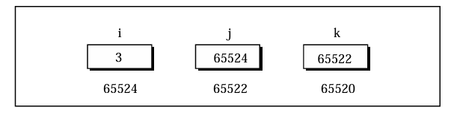
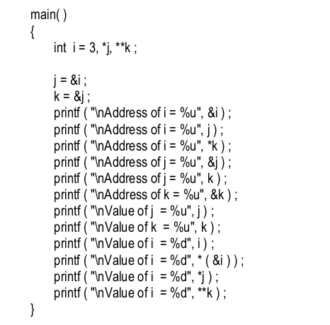
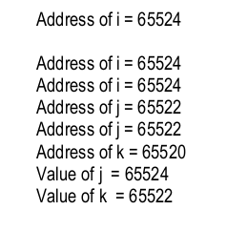
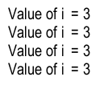
C pointers

Slide 15
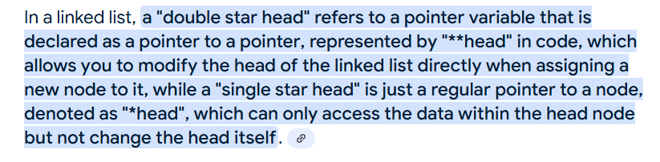
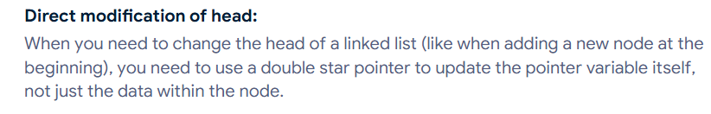
Important Notes

Slide 16
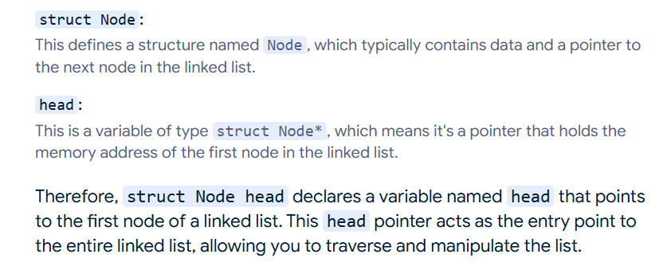

Slide 17
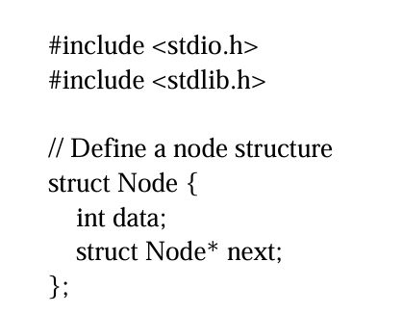
Linked list lab program

Slide 18
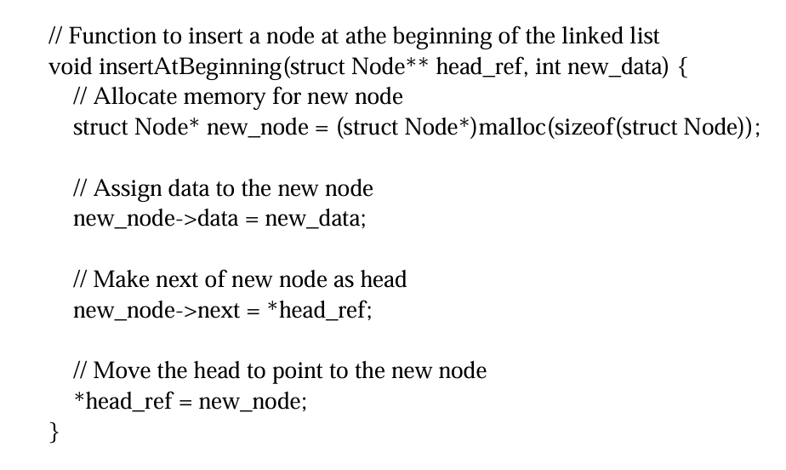

Slide 19
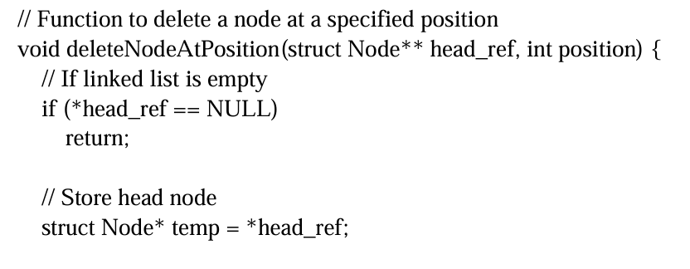

Slide 20
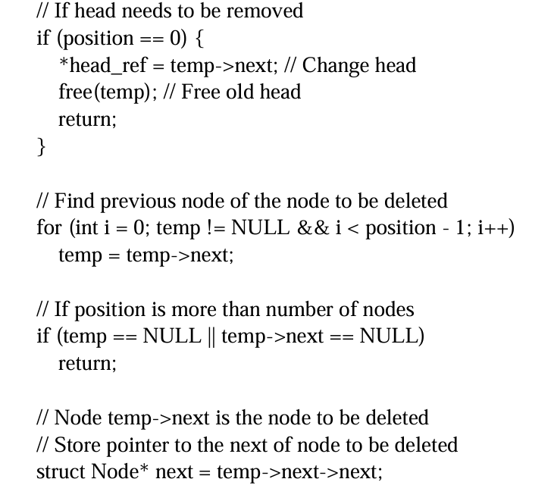

Slide 21
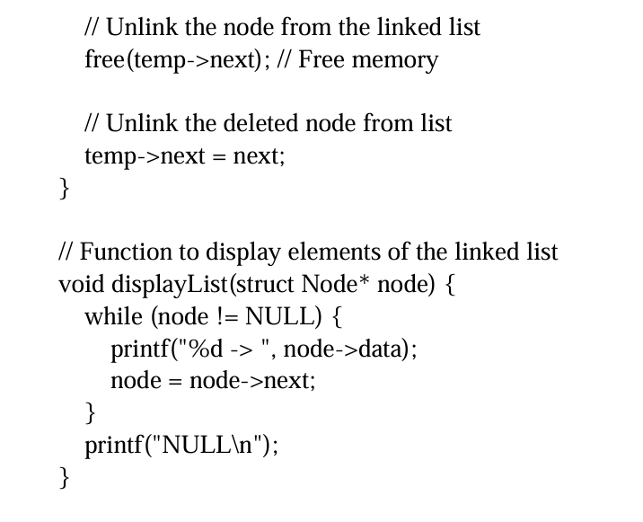

Slide 22
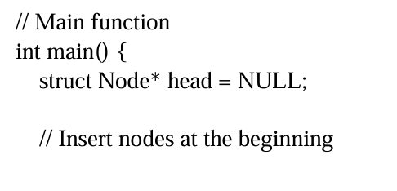
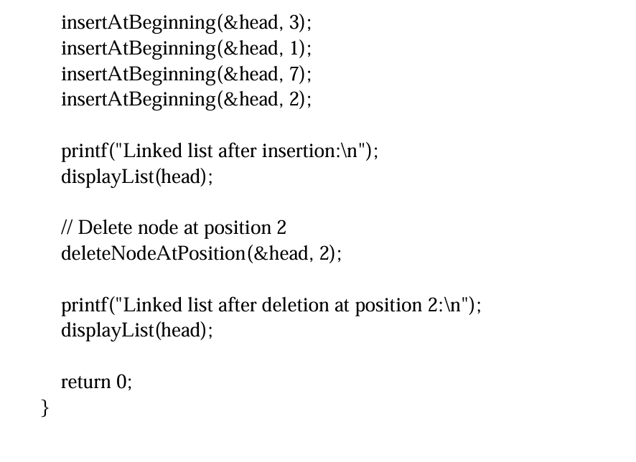

Slide 23
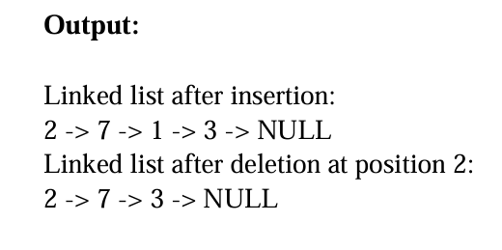

Slide 24
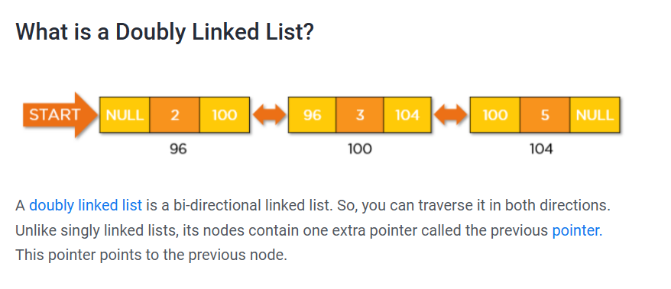
Doubly Linked List (DLL)

Slide 25
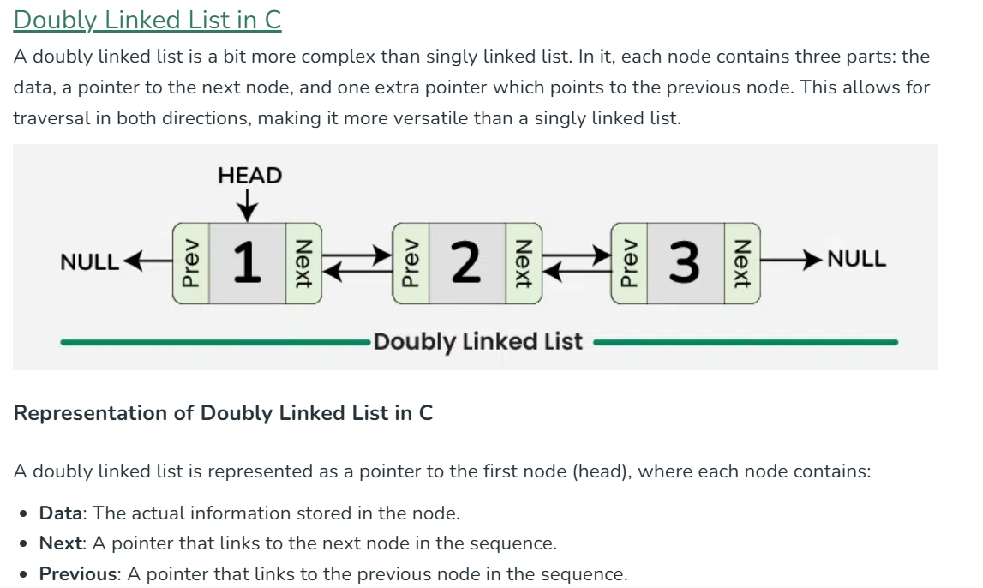

Slide 26
// Structure to represent the doubly linked list
struct Node {
// Data field - can be of any type and count
int data;
// Pointer to the next node
Node* next;
// Pointer to the previous node
Node* prev;
}

Slide 27
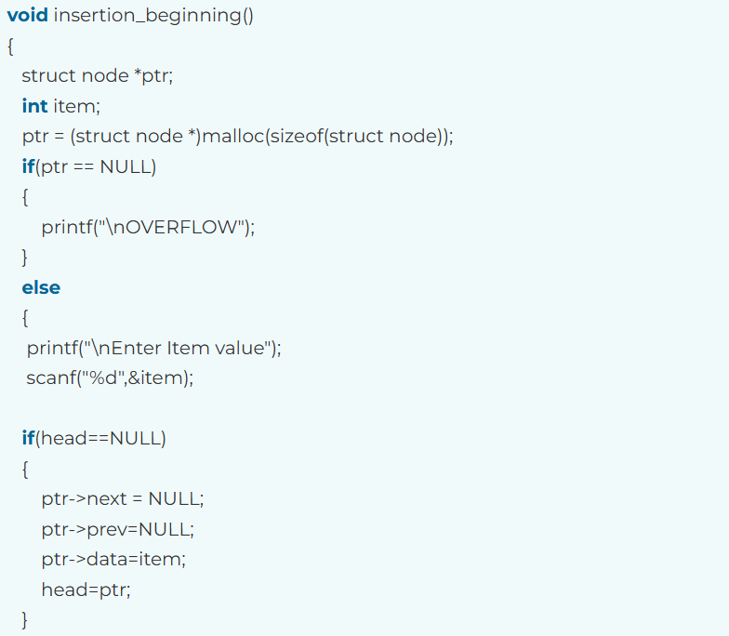
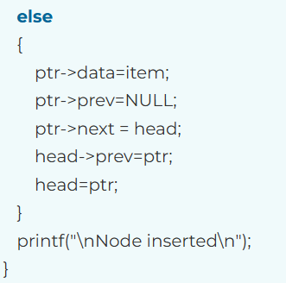

Slide 28
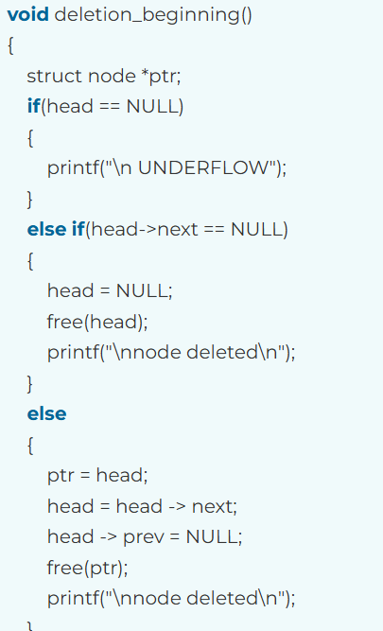

Slide 29
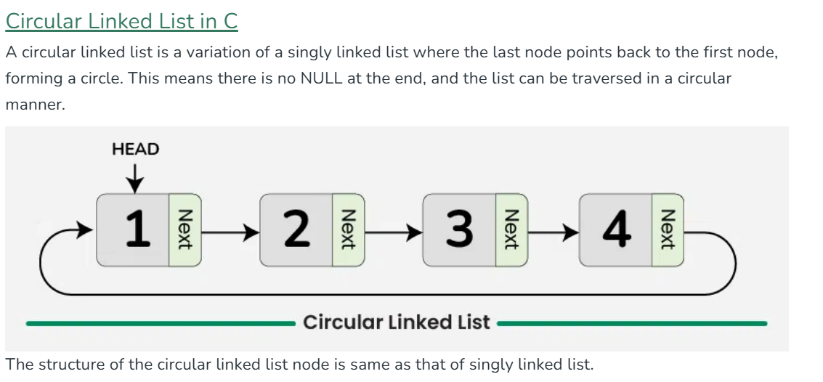
Circular Linked List (CLL)

Slide 30
// Structure to represent the circular linked list
struct Node {
// Data field - can be of any type and count
int data;
// Pointer to the next node
Node* next;
}

Slide 31


Slide 32
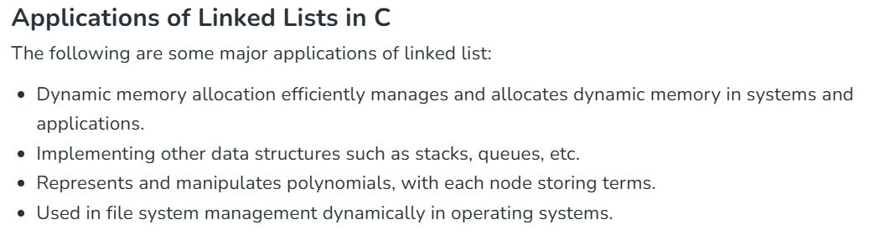

Slide 33
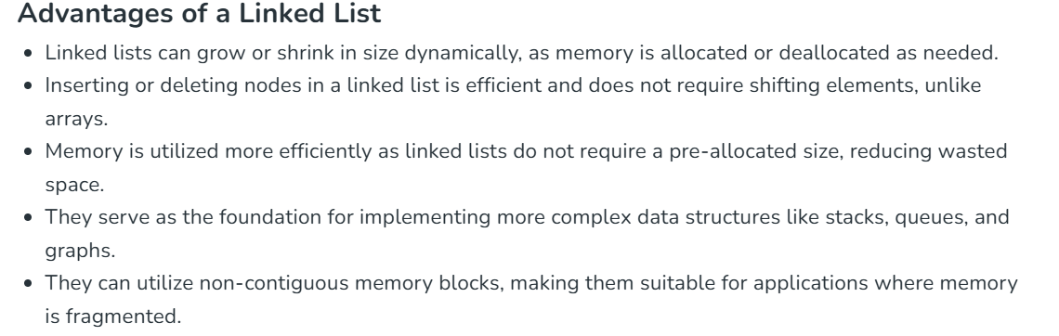
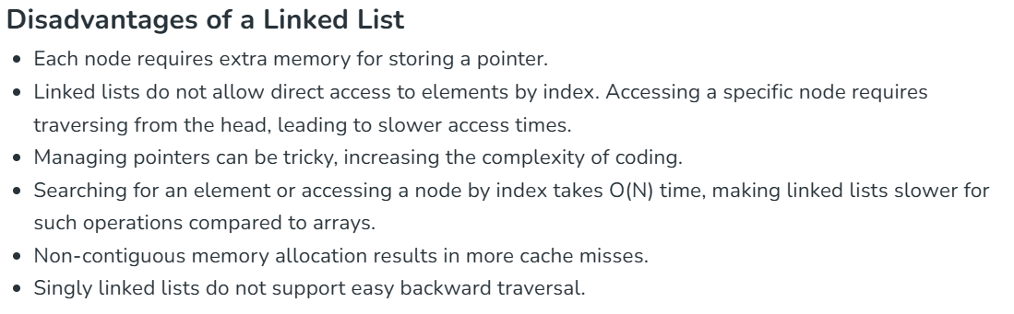

Slide 34
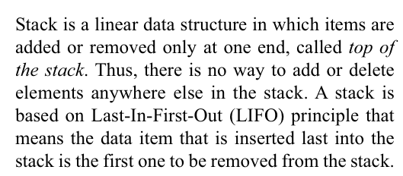
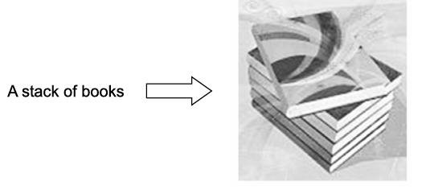
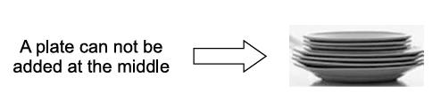
STACK

Slide 35

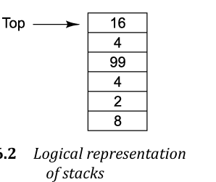

Slide 36
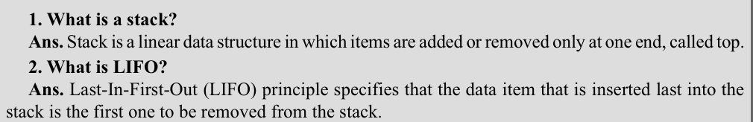

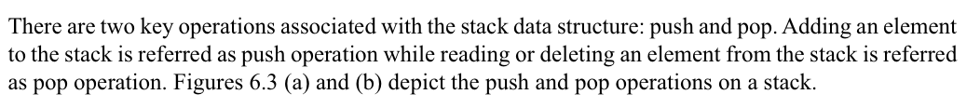



Slide 37
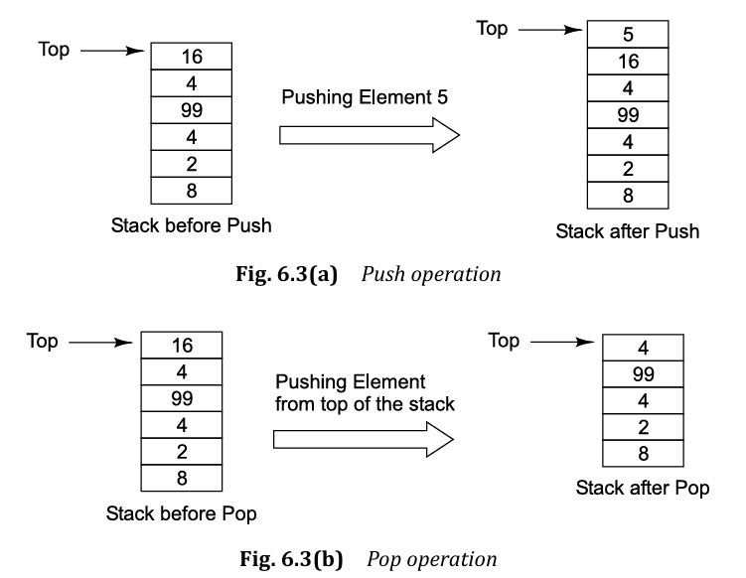

Slide 38





Slide 39

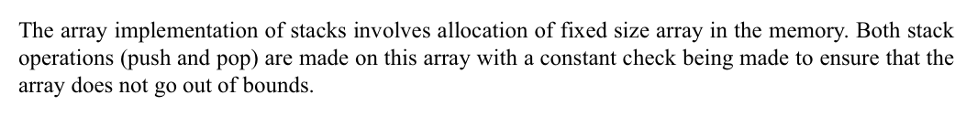
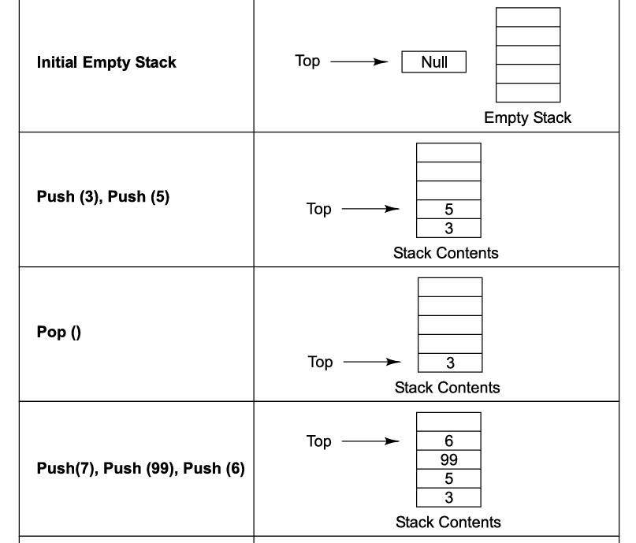

Slide 40
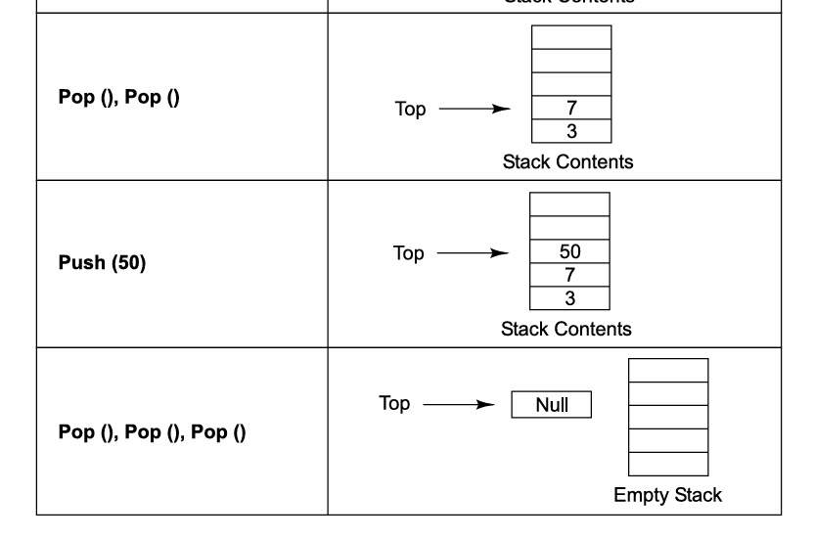

Slide 41
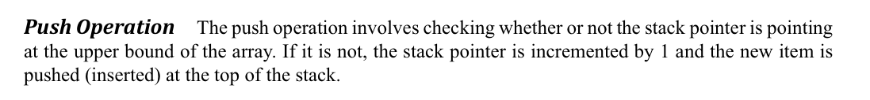
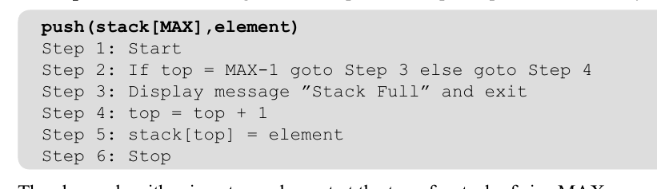

Slide 42
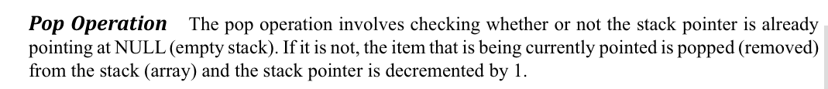
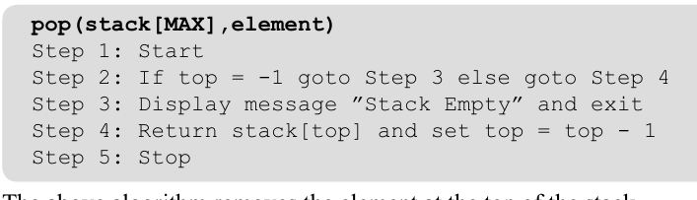

Slide 43
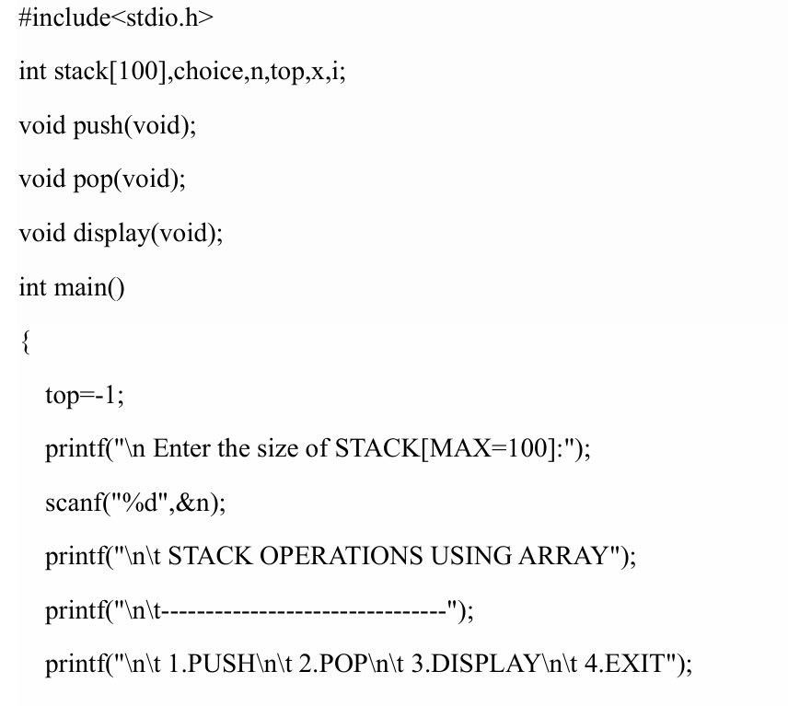

Slide 44
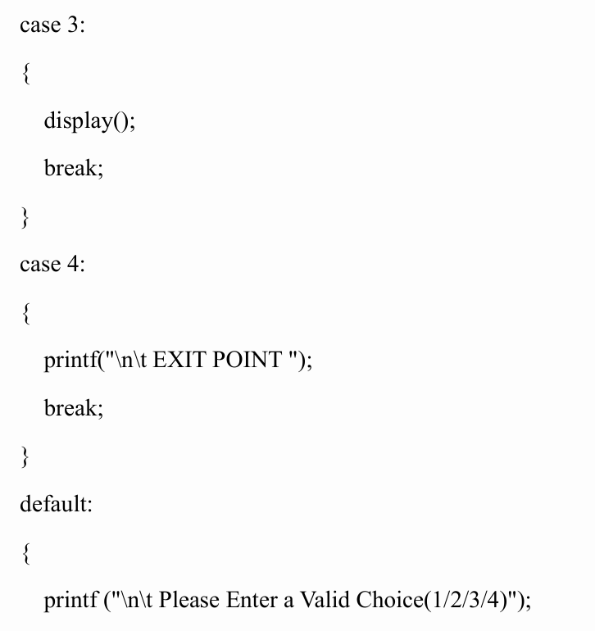
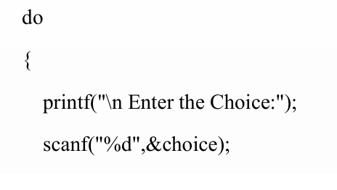
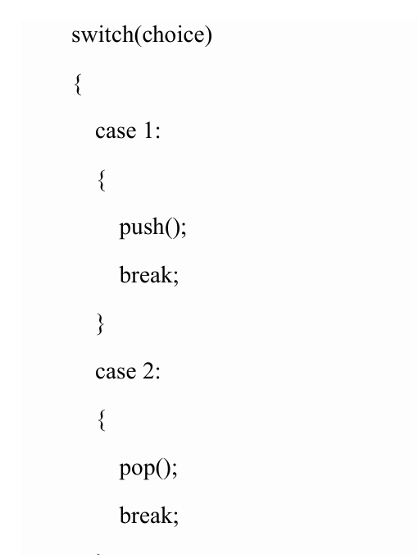

Slide 45
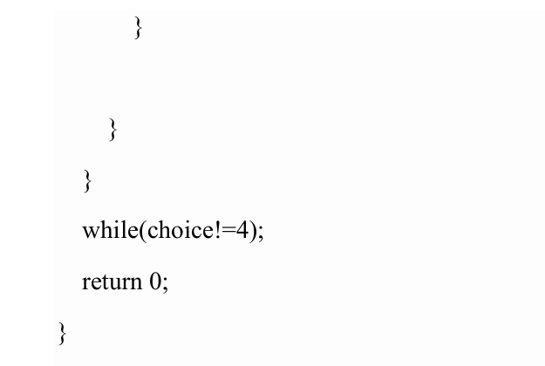

Slide 46


Slide 47



Slide 48


Slide 49



Slide 50


Slide 51


Slide 52



Queue

Slide 53



Slide 54


Slide 55

Operations

Slide 56


Slide 57


Slide 58

Queue Applications

Slide 59
Linear Queue using Arrays (lab program- Part-B)
#include <stdio.h>
#include <stdlib.h>
#define QUEUE_SIZE 5
int myQueue[QUEUE_SIZE];
int iFront = 0, iRear = -1;
void fnInsertRear();
void fnDeleteFront();
void fnDisplay();

Slide 60
int main()
{
int iElem, iChoice;
for(;;)
{
printf("\nQueue Operations\n");
printf("=====================");
printf("\n1.Qinsert\n2.Qdelete\n3.Qdisplay\n4.Exit\n");
printf("Enter your choice\n");
scanf("%d",&iChoice);

Slide 61
switch(iChoice)
{
case 1: if(iRear == QUEUE_SIZE-1)
{
printf("\nQueue is Full\n");
}
else
{
fnInsertRear();
}
break;

Slide 62
case 2: if(iRear == iFront-1)
{
printf("\nQueue is Empty\n");
}
else
{
fnDeleteFront(); }
break;

Slide 63
case 3: if(iRear == iFront-1) {
printf("\nQueue is Empty\n");
}
else
{
printf("\nContents of the Queue is \n");
fnDisplay();
} break;

Slide 64
case 4: exit(0);
default: printf("\nInvalid choice\n");
break;
}
}
return 0; }

Slide 65
void fnInsertRear()
{
int iVal;
printf("\nEnter the element to be inserted : ");
scanf("%d", &iVal);
iRear++;
myQueue[iRear] = iVal;
}

Slide 66
void fnDeleteFront()
{
int iElem;
iElem = myQueue[iFront];
if(iFront == iRear) {
iFront = 0;
iRear = -1;
}
else {
iFront++;
}
printf("\nElement deleted is %d\n", iElem); }

Slide 67
void fnDisplay(int queue[], int f, int r)
{
int i;
for(i=iFront; i<=iRear; i++)
{
printf("%d\t", myQueue[i]);
}
printf("\n");
}

Slide 68


Slide 69


Circular Queue

Slide 70

What is circular queue

Slide 71


Slide 72


Slide 73


Slide 74


Algorithm

Slide 75



Slide 76


Slide 77

Priority Queue

Slide 78



Slide 79


Slide 80


Slide 81

Deque (or double-ended queue)
What is a Deque (or double-ended queue)
The deque stands for Double Ended Queue. Deque is a linear data structure where the insertion and deletion operations are performed from both ends. We can say that deque is a generalized version of the queue.
Though the insertion and deletion in a deque can be performed on both ends, it does not follow the FIFO rule. The representation of a deque is given as follows -

Slide 82


Slide 83
#include <stdio.h>
#include <stdlib.h>
#include <stdbool.h>
#define QUEUE_SIZE 5
int myQueue[QUEUE_SIZE];
int iFront = -1, iRear = -1;
void fnInsertRear();
void fnDeleteFront();
void fnDisplay();

Slide 84
int main()
{
int iChoice;
for(;;)
{
printf("\nQueue Operations\n");
printf("=====================");
printf("\n1.Qinsert\n2.Qdelete\n3.Qdisplay\n4.Exit\n");
printf("Enter your choice\n");
scanf("%d",&iChoice);

Slide 85
switch(iChoice)
{
case 1: if((iRear + 1) % QUEUE_SIZE == iFront)
{
printf("\nQueue is Full\n");
}
else
{
fnInsertRear();
}
break;

Slide 86
case 2: if(iFront == -1)
{
printf("\nQueue is Empty\n");
}
else
{
fnDeleteFront(myQueue, &iFront, &iRear);
}
break;

Slide 87
case 3: if(iFront == -1) {
printf("\nQueue is Empty\n"); }
else
{
printf("\nContents of the Queue is \n");
fnDisplay();
} break;
case 4: exit(0);
default: printf("\nInvalid choice\n");
break;
} }
return 0; }

Slide 88
void fnInsertRear()
{ int iVal;
printf("\nEnter the element : ");
scanf("%d", &iVal);
if(iRear == -1)
{
iFront++;
iRear++;
} else
iRear = (iRear + 1)%QUEUE_SIZE;
myQueue[iRear] = iVal;
}

Slide 89
void fnDeleteFront()
{
int iElem;
iElem = myQueue[iFront];
if(iFront == iRear)
{
iFront = -1;
iRear = -1;
} else {
iFront = (iFront + 1)%QUEUE_SIZE;
}
printf("\nDeleted element is %d\n", iElem); }

Slide 90
void fnDisplay()
{ int i;
if(iFront <= iRear) {
for(i=iFront; i<=iRear; i++)
{
printf("%d\t", myQueue[i]);
}
printf("\n");
} else {
for(i=iFront; i<=QUEUE_SIZE-1; i++) {
printf("%d\t", myQueue[i]);
}
for(i=0; i<=iRear; i++) {
printf("%d\t", myQueue[i]);
} printf("\n");
}
}

